Slide 1

Module 6: Showing Results with Gauge Views
0/5
Analytics: Advanced Application Developer

Slide 2
Module Objectives
After completing this module you will be able to:
  Display results in a gauge view
  Set gauge view properties
  Modify gauge ranges
  Modify gauge titles and footers
  Set gauge interaction
Why you need to know:
  An understanding of these topics will improve your ability to create and modify gauge views, which are useful for showing performance against goals

Slide 3
Gauge Views
Show results in gauges
Are useful for showing performance against goals
Support dial, bar, and bulb-style gauges

Slide 4
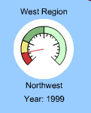
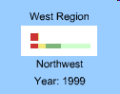
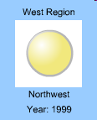
Gauge Types
Available gauge types and their uses
Gauge Type | Description
Dial | Shows data using a dial with one or more indicator needles Needles change position to indicate where data falls within predefined limits
Bar | Shows data using a simple bar Bar changes color to indicate whether data is within predefined limits
Bulb | Show data using a circle Circle changes color to indicate whether data is within predefined limits Useful for scorecard-type output
Dial
Bar
Bulb

Slide 5
Working with Gauge Views
0/6
Adding a Gauge View
Setting General Background Properties
Adding Titles and Footers
Adding Gauge Ranges
Setting Additional Gauge Properties
Setting Advanced Properties for Dial Gauge

Slide 6
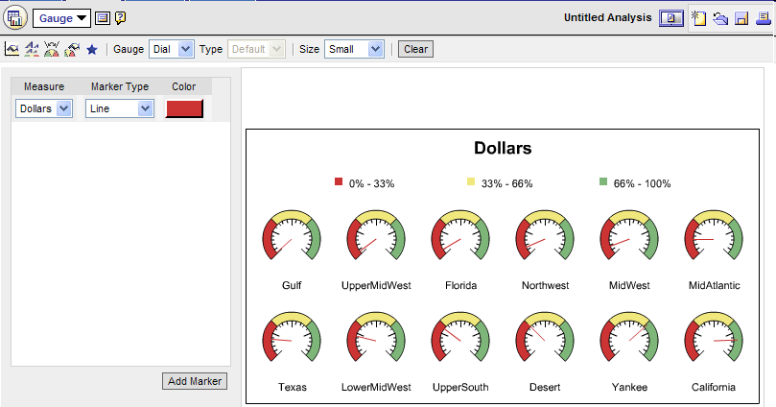
1. Adding a Gauge View
1/6
Select Add View > Gauge from the views list
Select gauge type
Select gauge size
Select marker type and color for dial gauges
Select gauge measure
Add markers (additional measures)

Slide 7
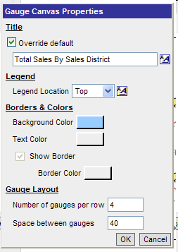
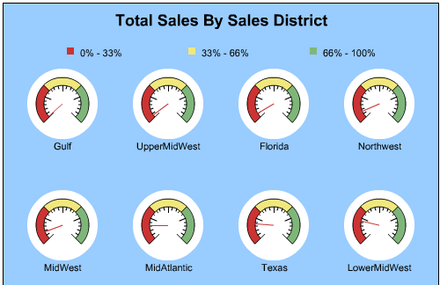
2. Setting General Background Properties
2/6
Set general properties for the background on which the gauges appear
Click gauge canvas properties button
Add and format title
Locate and format legend
Format background, text, and borders
Format gauge layout

Slide 8
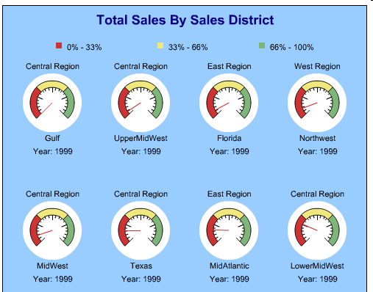
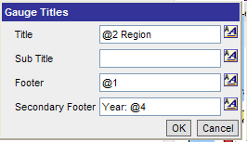
3. Adding Titles and Footers
3/6
Specify title, subtitle, footer, and secondary footer
Click gauge titles button
Add and format text
Use @n to include results from columns

Slide 9
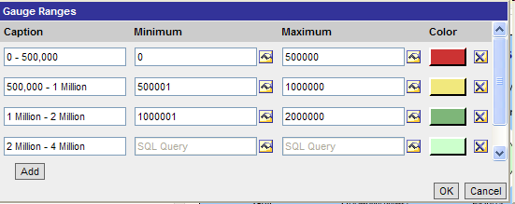
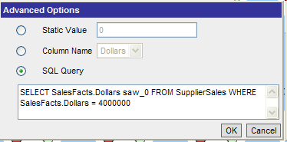
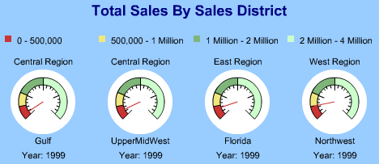
4. Adding Gauge Ranges
4/6
Identify minimum and maximum values for each range
Click gauge ranges button
Range captions
Range values
Range colors
Set range values to static, column name, or result of SQL query

Slide 10
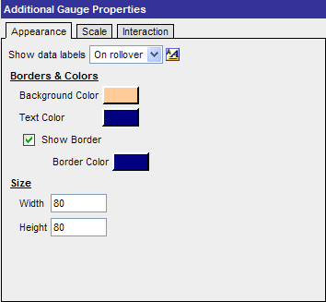
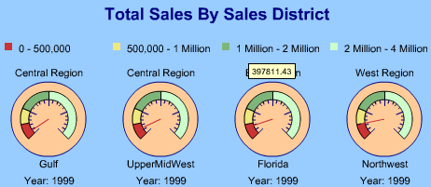
5. Setting Additional Gauge Properties: Appearance
5/6
Control appearance of gauge elements
Click additional gauge properties button
Select when data labels appear
Data label
Background, text, and border colors
Height and width in pixels

Slide 11
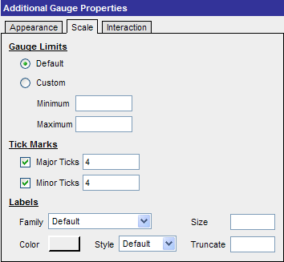
5. Setting Additional Gauge Properties: Scale
5/6
Control scale properties for gauges
Click additional gauge properties button
Select default or custom gauge limits
Set number of major and minor ticks
Modify gauge labels

Slide 12
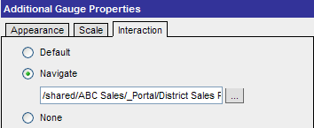
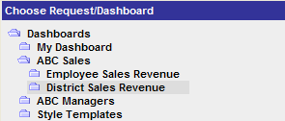
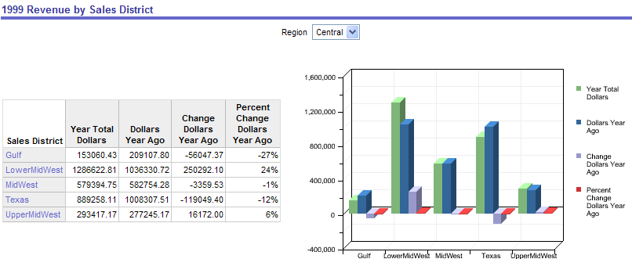
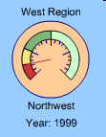
5. Setting Additional Gauge Properties: Interaction
5/6
Allows users to navigate to another saved request or dashboard
Click additional gauge properties button
Browse to saved request or dashboard
Drill down on gauge

Slide 13
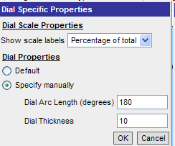
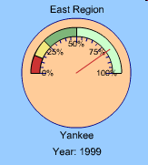
6. Setting Advanced Properties for Dial Gauge
6/6
Provides ability to set additional advanced properties for dial gauges
Click advanced properties button
Set scale label display
Set dial arc length and thickness

Slide 14
Summary
This module showed you how to:
  Display results in a gauge view
  Set gauge view properties
  Modify gauge ranges
  Modify gauge titles and footers
  Set gauge interaction

Slide 15
Lab
In the lab you will:
  Display results of Siebel Answers requests in gauge views

